Slide 1


MUTE: Bringing IoT to Noise Cancellation
Sheng Shen, Nirupam Roy, Junfeng Guan, Haitham Hassanieh, Romit Roy Choudhury

Slide 2
Noise is everywhere …

Slide 3


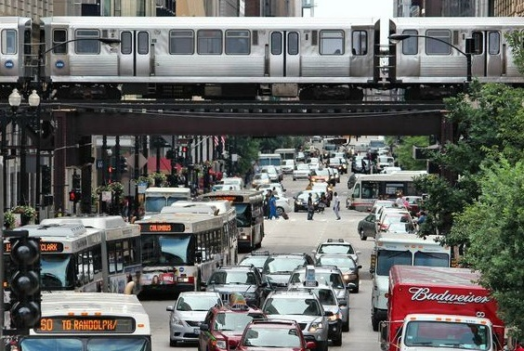
Coworker Chatting over Phone
Construction Site
Lawn Mower in Early Morning
Busy Streets in Cities

Slide 4
Existing Solutions

Slide 5

Better Noise Cancellation
Existing Solutions
9dB Better
This Paper

Slide 6
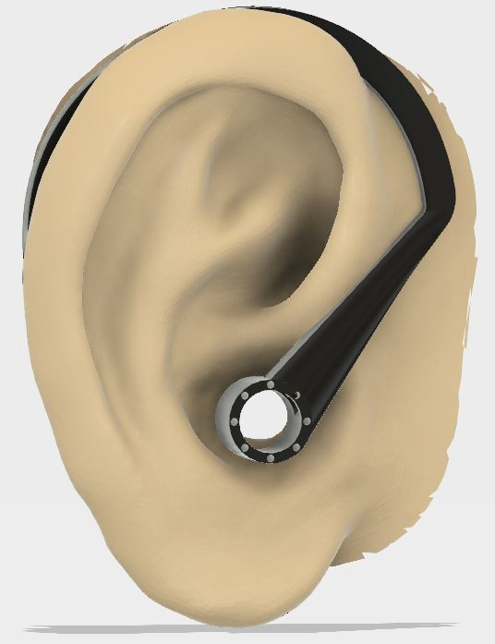
Better Noise Cancellation
Existing Solutions
9dB Better
This Paper
Better Form Factor
(Hollow)
Comparable Performance

Slide 7
Our System: MUTE
Wireless Networking
+
Noise Cancellation

Slide 8


Alice

Slide 9


1. Sound starts
Alice

Slide 10

2. IoT relay forwards sound over wireless
1. Sound starts
Alice

Slide 11
2. IoT relay forwards sound over wireless
1. Sound starts
Wireless radios travel a million times faster than sound
Alice

Slide 12
2. IoT relay forwards sound over wireless
3. Wireless arrives at ear-device earlier
1. Sound starts
Alice

Slide 13
2. IoT relay forwards sound over wireless
3. Wireless arrives at ear-device earlier
1. Sound starts
4. Actual sound
arrives later
Alice

Slide 14
2. IoT relay forwards sound over wireless
3. Wireless arrives at ear-device earlier
1. Sound starts
4. Actual sound
arrives later
Lookahead
Alice

Slide 15
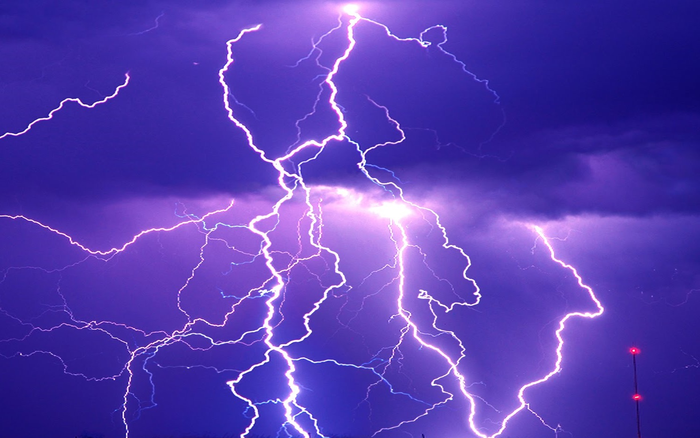
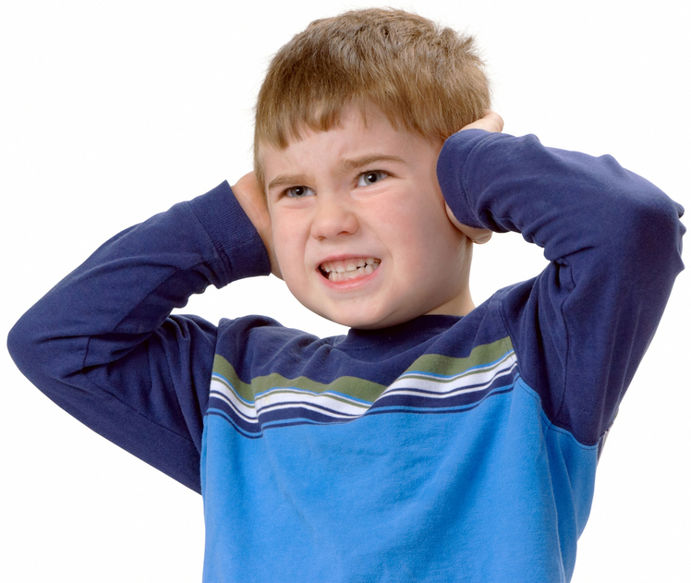
Analogy: Light travels much faster than sound
Lookahead allows us to cover ears in time
MUTE: Leverage lookahead for noise cancellation

Slide 16
Talk Outline
How can MUTE leverage lookahead?
Timing Gain →
Wideband Cancellation
Signal Processing Gain →
Non-Causal Filtering
Application-Specific Gain →
Sound Source Profiling

Slide 17
Talk Outline
How can MUTE leverage lookahead?
Timing Gain →
Wideband Cancellation
Signal Processing Gain →
Non-Causal Filtering
Application-Specific Gain →
Sound Source Profiling

Slide 18
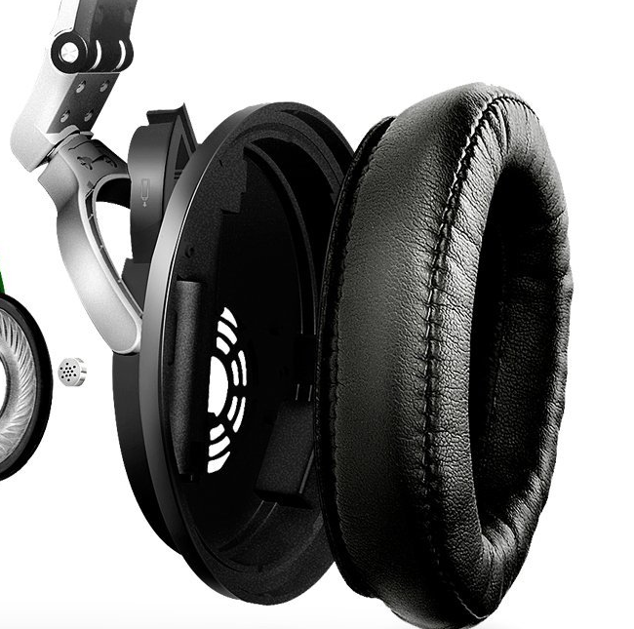
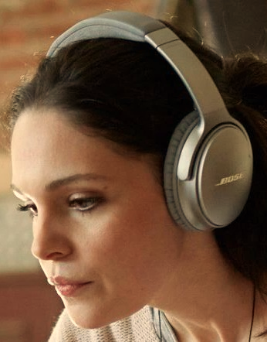
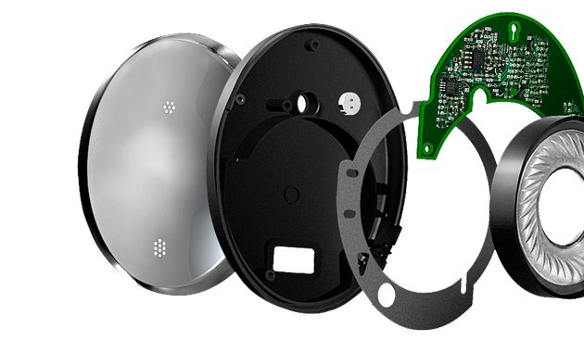
Noise Cancelling Headphones
-- What is inside?

Slide 19

Noise Cancellation Primer
Ref. Mic.
DSP
Anti-Noise Speaker

Slide 20
Noise Cancellation Primer
Ref. Mic.
DSP
Anti-Noise
Speaker

Slide 21
Noise Cancellation Primer
Ref. Mic.
DSP
Anti-Noise
Speaker

Slide 22
Noise Cancellation Primer
Ref. Mic.
DSP
Anti-Noise
Speaker

Slide 23
Noise Cancellation Primer
Noise
Anti-Noise
Ref. Mic.
DSP
Anti-Noise
Speaker

Slide 24
Noise Cancellation Primer
Ref. Mic.
DSP
Anti-Noise
Feedback Mic.
Speaker
(Error Feedback)

Slide 25
How do they perform today?

Slide 26
Active noise cancellation only at low frequencies
Bose QC35
Bad
Good

Slide 27
Active noise cancellation only at low frequencies
Bose QC35
Bad
Good

Slide 28
Active noise cancellation only at low frequencies
Sound absorbing material blocks high frequencies
Bose QC35
Bad
Good

Slide 29
Active noise cancellation only at low frequencies
Sound absorbing material blocks high frequencies
Bose QC35
Bad
Good

Slide 30
Why does noise cancellation not work at higher frequencies?
Let’s look into the headphone again.

Slide 31
Ref. Mic.
DSP
Speaker
Fb. Mic.
Time

Slide 32
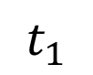
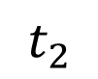
Ref. Mic.
DSP
Speaker
Fb. Mic.
Noise
$$t_{1}$$
$$t_{2}$$
Time

Slide 33
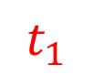
Ref. Mic.
DSP
Speaker
Fb. Mic.
Noise
$$t_{1}$$
$$t_{2}$$
Time

Slide 34
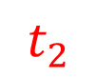
Ref. Mic.
DSP
Speaker
Fb. Mic.
Noise
$$t_{1}$$
$$t_{2}$$
Time

Slide 35
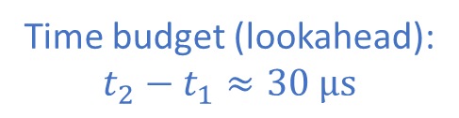
Ref. Mic.
DSP
Speaker
Fb. Mic.
Noise
1 cm
$$t_{1}$$
Time budget (lookahead): $$t_{2}−t_{1}≈30 μs$$
$$t_{2}$$
Time

Slide 36
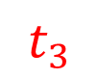
Ref. Mic.
DSP
Speaker
Fb. Mic.
Noise
$$t_{1}$$
Time budget (lookahead): $$t_{2}−t_{1}≈30 μs$$
$$t_{2}$$
$$t_{3}$$
Anti-Noise
Time

Slide 37
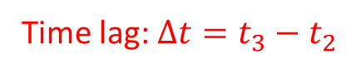
Ref. Mic.
DSP
Speaker
Fb. Mic.
Noise
$$t_{1}$$
Time budget (lookahead): $$t_{2}−t_{1}≈30 μs$$
$$t_{2}$$
Time lag: $Δt=t_{3}−t_{2}$
$$t_{3}$$
Anti-Noise
Time

Slide 38
Low Frequency:
Ref. Mic.
DSP
Speaker
Fb. Mic.
Noise
Noise
Anti-Noise
Residual Error
High Frequency:
Noise
Anti-Noise
Anti-Noise
Residual Error
Time

Slide 39
Ref. Mic.
DSP
Speaker
Fb. Mic.
Noise
Anti-Noise
Time

Slide 40

Let’s now look at noise cancellation in MUTE ...

Slide 41
Ref. Mic.
DSP
Speaker
Fb. Mic.
Noise
$$t_{1}$$
$$t_{2}$$
Time

Slide 42
Ref. Mic.
DSP
Speaker
Fb. Mic.
Noise
$$t_{1}$$
$$t_{2}$$
Time

Slide 43
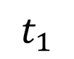
Ref. Mic.
DSP
Speaker
Fb. Mic.
Noise
$$t_{1}$$
$$t_{2}$$
Time

Slide 44
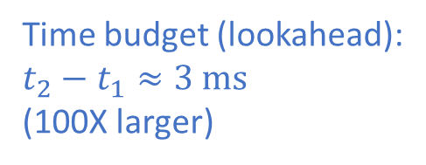
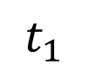
Ref. Mic.
DSP
Speaker
Fb. Mic.
Noise
$$t_{1}$$
1 m
Time budget (lookahead): $t_{2}−t_{1}≈3 ms$ (100X larger)
$$t_{2}$$
Time

Slide 45
Ref. Mic.
DSP
Speaker
Fb. Mic.
Noise
$$t_{1}$$
Time budget (lookahead): $t_{2}−t_{1}≈3 ms$ (100X larger)
$$t_{2}$$
Anti-Noise
Time

Slide 46
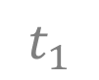
Ref. Mic.
DSP
Speaker
Fb. Mic.
Noise
$$t_{1}$$
Cancel high frequencies
Noise
Time budget (lookahead): $t_{2}−t_{1}≈3 ms$ (100X larger)
Anti-Noise
Residual Error
Anti-Noise
Time

Slide 47
Talk Outline
How can MUTE leverage lookahead?
Timing Gain →
Wideband Cancellation
Signal Processing Gain →
Non-Causal Filtering
Application-Specific Gain →
Sound Source Profiling

Slide 48
Talk Outline
How can MUTE leverage lookahead?
Timing Gain →
Wideband Cancellation
Signal Processing Gain →
Non-Causal Filtering
Application-Specific Gain →
Sound Source Profiling

Slide 49
Noise Cancellation Primer
Different
DSP
Ref. Mic.
Feedback Mic.

Slide 50
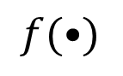
Noise Cancellation Primer
$$f(•)$$
DSP
Ref. Mic.
Feedback Mic.

Slide 51
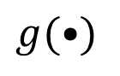

Noise Cancellation Primer
$$g(•)$$
$$f(•)$$
DSP
Ref. Mic.
Feedback Mic.

Slide 52
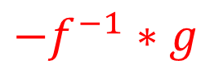
Noise Cancellation Primer
$$g(•)$$
$$f(•)$$
$${−f}^{−1}∗g$$
Ref. Mic.
Feedback Mic.

Slide 53
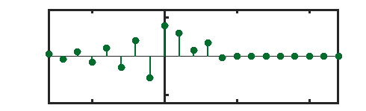

$${−f}^{−1}∗g$$
Ref. Mic.
Feedback Mic.
Channel Impulse Response
Future
Current
Past

Slide 54
$${−f}^{−1}∗g$$
Ref. Mic.
Feedback Mic.
Channel Impulse Response
Future
Current
Past
Today’s Headphones (Causal)
MUTE (Non-Causal)
Lookahead
“Lookahead” → Non-Causal Filtering → Better Cancellation

Slide 55
Talk Outline
How can MUTE leverage lookahead?
Timing Gain →
Wideband Cancellation
Signal Processing Gain →
Non-Causal Filtering
Application-Specific Gain →
Sound Source Profiling

Slide 56
Talk Outline
How can MUTE leverage lookahead?
Timing Gain →
Wideband Cancellation
Signal Processing Gain →
Non-Causal Filtering
Application-Specific Gain →
Sound Source Profiling

Slide 57


Slide 58
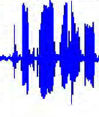
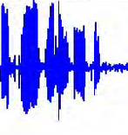
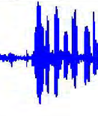
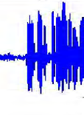
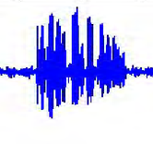


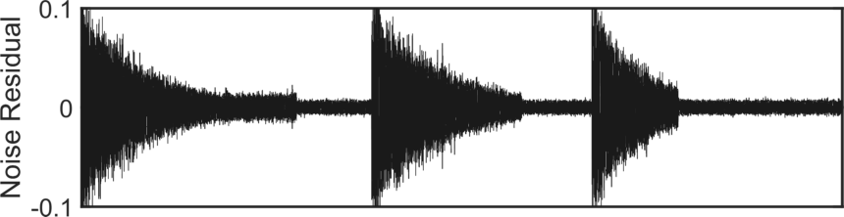
Alice
Bob
Alice

Slide 59
Alice
Bob
Alice

Slide 60
Alice
Bob
Alice

Slide 61
With lookahead …

Slide 62
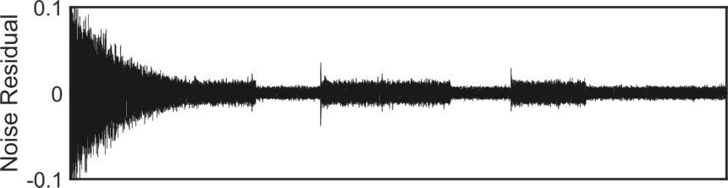
Alice
Bob
Alice

Slide 63
Alice
Bob
Alice

Slide 64
Alice
Bob
Alice

Slide 65
Talk Outline
How can MUTE leverage lookahead?
Timing Gain →
Wideband Cancellation
Signal Processing Gain →
Non-Causal Filtering
Application-Specific Gain →
Sound Source Profiling

Slide 66
Implementation & Evaluation

Slide 67
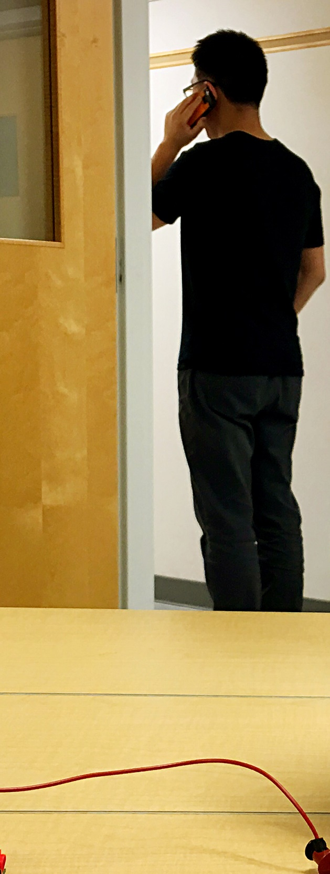
MUTE Platform
Noise Source

Slide 68

MUTE Platform
IoT Relay
Noise Source

Slide 69
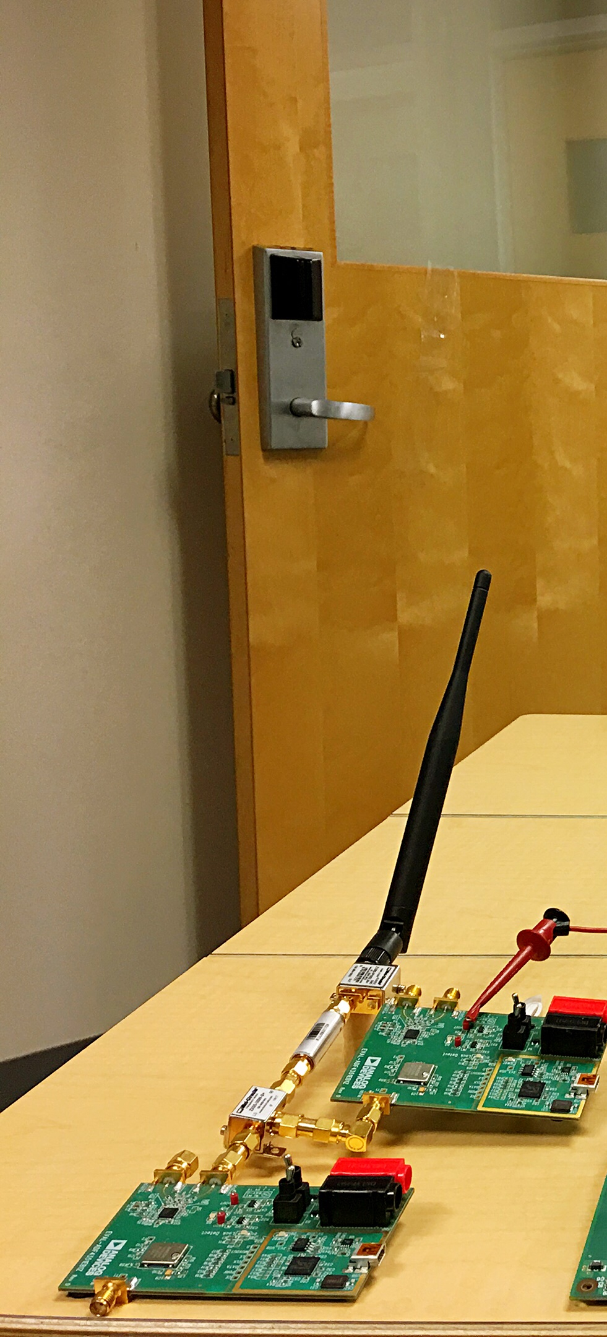
MUTE Platform
IoT Relay
Noise Source
Wireless Receiver

Slide 70
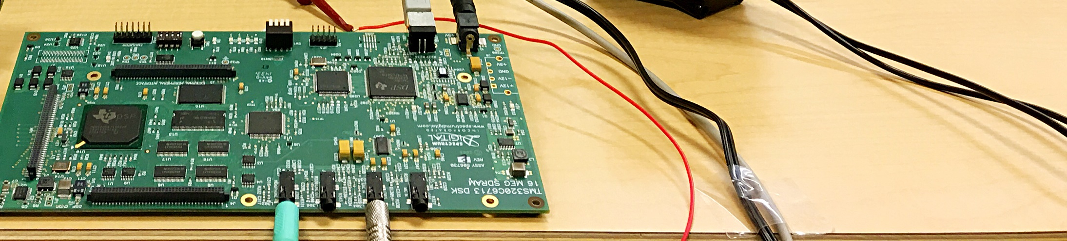
MUTE Platform
IoT Relay
Noise Source
Wireless Receiver
DSP Processor

Slide 71
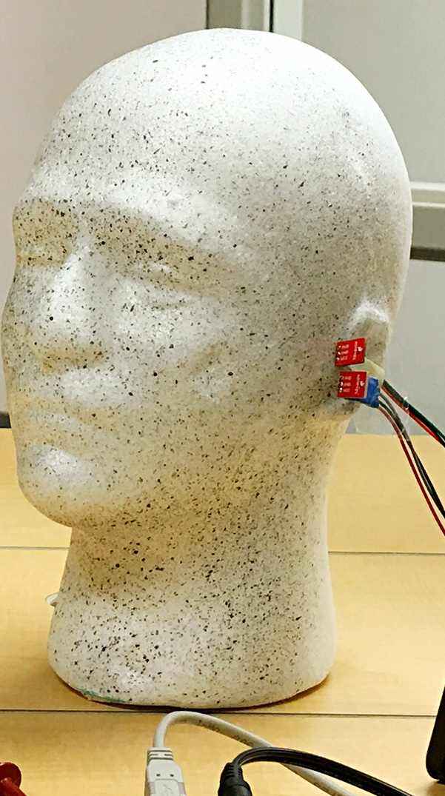
MUTE Platform
IoT Relay
Noise Source
Feedback Microphone
Wireless Receiver
DSP Processor

Slide 72
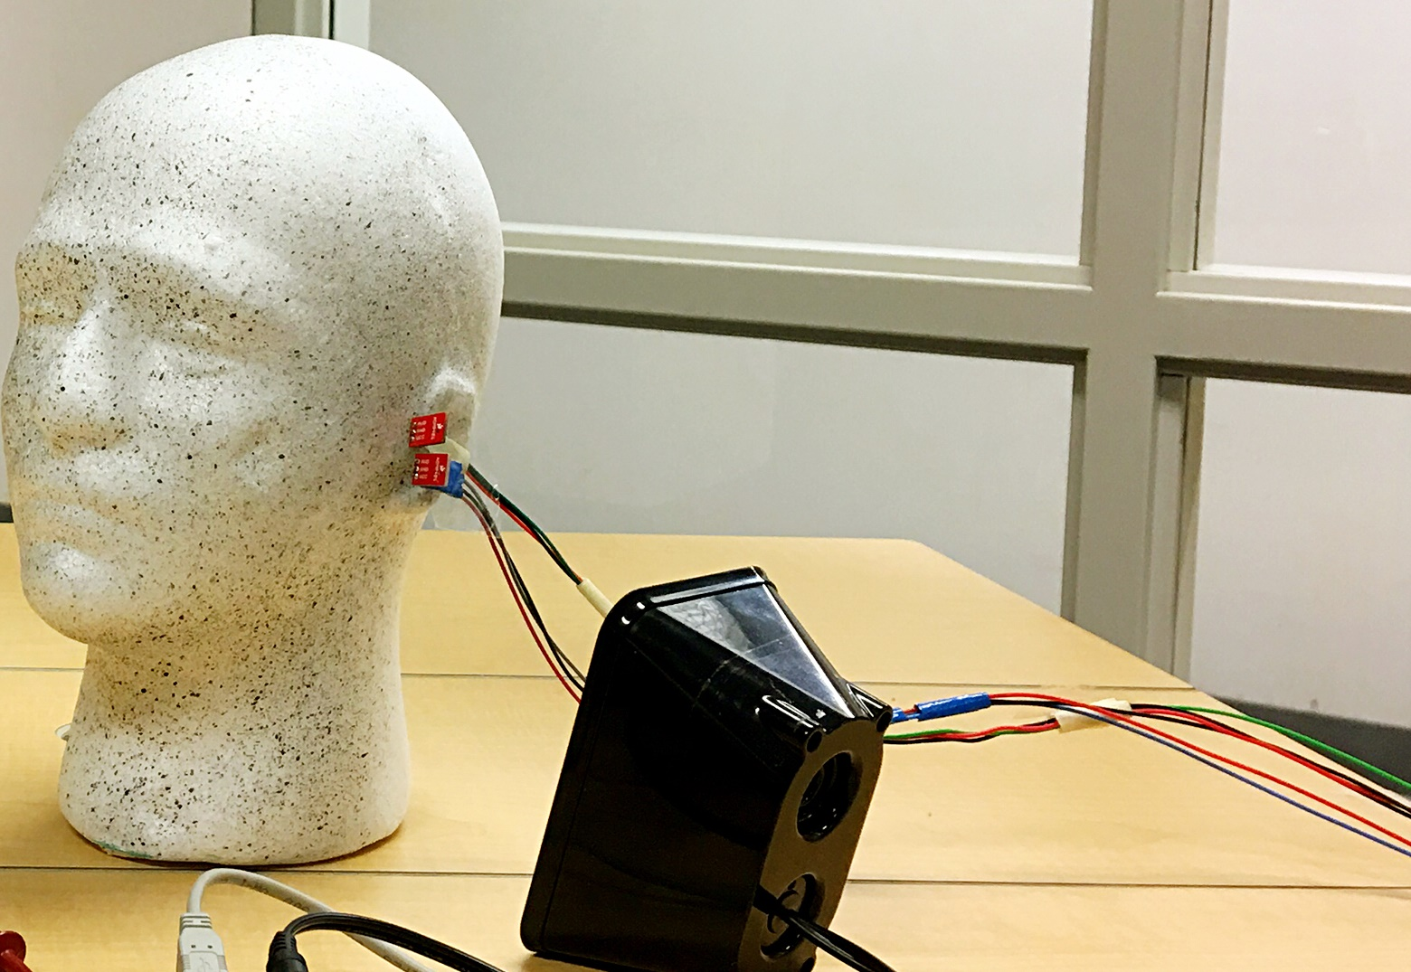
MUTE Platform
IoT Relay
Noise Source
Feedback Microphone
Wireless Receiver
Anti-Noise Speaker
DSP Processor

Slide 73
MUTE Platform
MUTE (Hollow)

Slide 74
MUTE Platform
MUTE (Hollow)

Slide 75
Evaluation
Goal: Comparable Performance
MUTE (Hollow)
Ear Blocking Headphone

Slide 76
1. Bose headphone
2. MUTE hollow design (comfort)

Slide 77
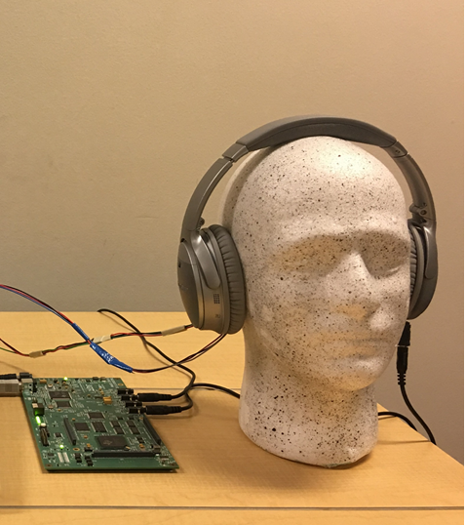
Evaluation
Goal: Better Performance
MUTE (Non-Hollow)
Ear Blocking Headphone

Slide 78
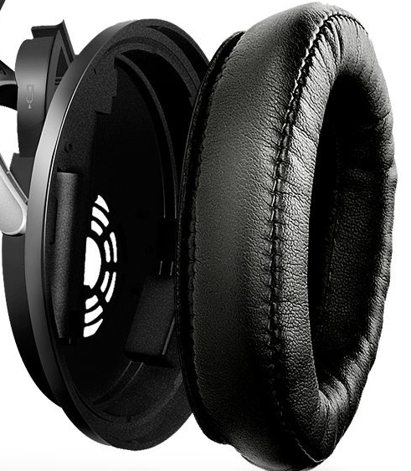
1. Bose headphone
2. MUTE hollow design (comfort)
3. MUTE non-hollow design (performance)
+

Slide 79
Finishing up

Slide 80
Wireless Signal

Slide 81
MUTE Tabletop Relay
Wireless Signal

Slide 82

MUTE Tabletop Relay
DSP
Wireless Signal

Slide 83
MUTE Tabletop Relay
Anti-Noise over
Wireless Signal
DSP

Slide 84

Noise Cancellation as an Edge Service
DSP

Slide 85
Noise Cancellation as an Edge Service
DSP
Anti-Noise for Alice
Feedback

Slide 86


MUTE Enabled Noise Sources

Slide 87
Conclusion
Wireless Control Plane
Acoustic Data Plane
Acoustic
Noise Cancellation
MUTE Tabletop Relay
MUTE Edge Service
MUTE Noise Source

Slide 88
Conclusion
Wireless Control Plane
Acoustic Data Plane
On-Ear Machine Learning
Acoustic
Noise Cancellation
Acoustic Augmented Reality
…
MUTE Tabletop Relay
MUTE Edge Service
MUTE Noise Source
https://synrg.csl.illinois.edu/anc

